Slide 1


Adversarial robustness of STDP-trained
spiking neural networks
CIDA Lab.
Presentation: Baekryun Seong
2024.08.01

Slide 2
Hebbian Learning
Adversarial Attacks
Methodology
Results
Discussion
Table of Contents

Slide 3
Intro: Reinforcement Learning
“… reinforcement learning has also interacted strongly with psychology and neuroscience, with substantial benefits going both ways. Of all the forms of machine learning, reinforcement learning is the closest to the kind of learning that humans and other animals do, and many of the core algorithms of reinforcement learning were originally inspired by biological learning systems. Reinforcement learning has also given back, both through a psychological model of animal learning that better matches some of the empirical data, and through an influential model of parts of the brain’s reward system.”

Slide 4
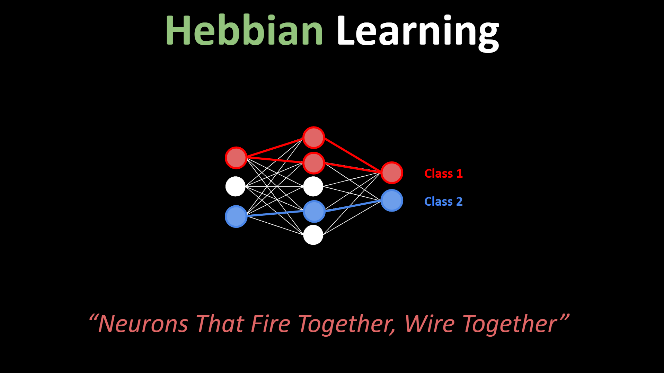
Hebbian Learning

Slide 5
Hebbian Learning
“Let us assume that the persistence or repetition of a reverberatory activity (or "trace") tends to induce lasting cellular changes that add to its stability. ... When an axon of cell A is near enough to excite a cell B and repeatedly or persistently takes part in firing it, some growth process or metabolic change takes place in one or both cells such that A’s efficiency, as one of the cells firing B, is increased.”
This statement is called Hebb’s Theory, or Hebbian learning rule. It is often summarized as “Neurons that fire together, wire together.”
In the early days of artificial intelligence, it was also used for perceptrons, and now it is mainly used for biologically plausible neural networks.
There are non-Hebbian learning dynamics in real neurons, but we will not discuss about it.

Slide 6
Hebbian Learning: Spike-Timing-Dependent Plasticity
“Spike-timing-dependent plasticity (STDP) is a biological process that adjusts the strength of connections between neurons in the brain. The process adjusts the connection strengths based on the relative timing of a particular neuron's output and input action potentials (or spikes). The STDP process partially explains the activity-dependent development of nervous systems, especially with regard to long-term potentiation and long-term depression.”

Slide 7
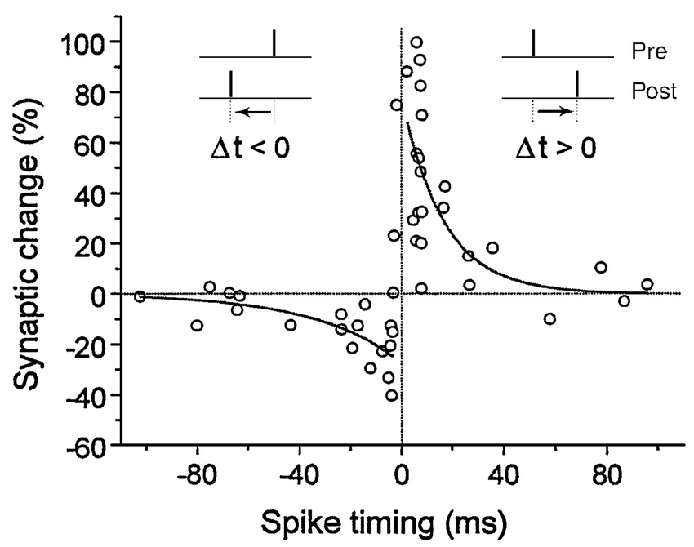
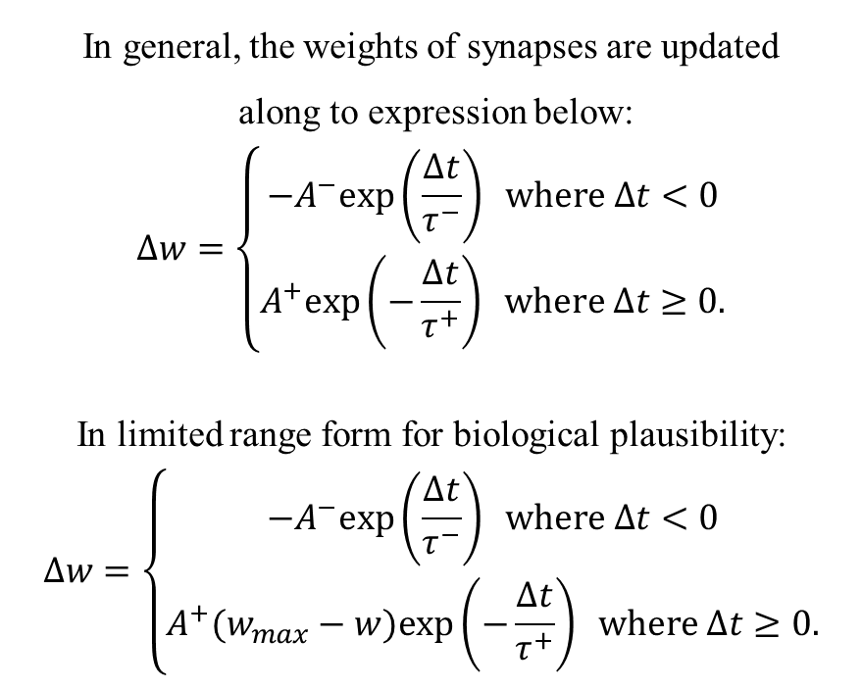
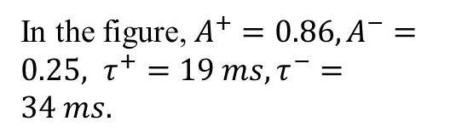
Hebbian Learning: Spike-Timing-Dependent Plasticity
In general, the weights of synapses are updated
along to expression below:
$$Δw=\left\{\begin{aligned}−A^{−}exp\left(\frac{Δt}{τ^{−}}\right) where Δt<0 \\ A^{+}exp\left(−\frac{Δt}{τ^{+}}\right) where Δt≥0.\end{aligned}\right.$$
In limited range form for biological plausibility:
$$Δw=\left\{\begin{aligned}−A^{−}exp\left(\frac{Δt}{τ^{−}}\right) where Δt<0 \\ A^{+}(w_{max}−w)exp\left(−\frac{Δt}{τ^{+}}\right) where Δt≥0.\end{aligned}\right.$$
In the figure, $A^{+}=0.86, A^{−}=0.25, τ^{+}=19 ms, τ^{−}=34 ms.$

Slide 8
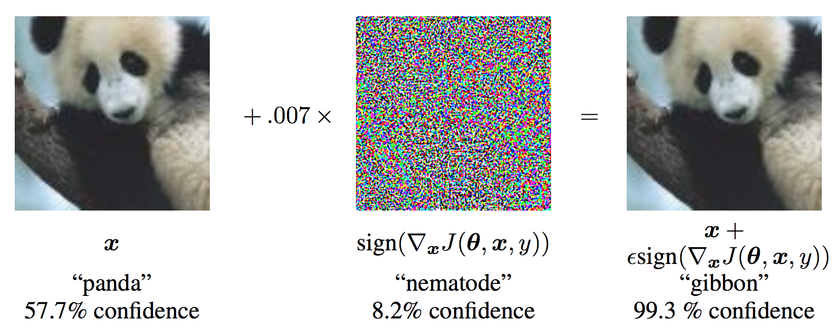
Adversarial Attacks

Slide 9
Adversarial Attacks: Categories
White-box attacks: The attackers are provided the target model information.
Black-box attacks: The attackers do not have the information.

Slide 10
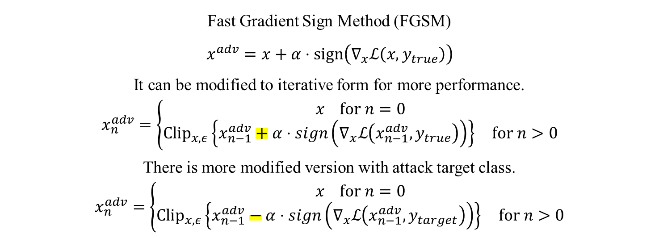
Adversarial Attacks: White-box Attacks
Fast Gradient Sign Method (FGSM)
$$x^{adv}=x+α⋅sign\left(∇_{x}ℒ\left(x,y_{true}\right)\right)$$
It can be modified to iterative form for more performance.
$$x_{n}^{adv}=\left\{\begin{aligned}x for n=0 \\ {Clip}_{x,ε}\left\{x_{n−1}^{adv}+α⋅sign\left(∇_{x}ℒ\left(x_{n−1}^{adv},y_{true}\right)\right)\right\} for n>0\end{aligned}\right.$$
There is more modified version with attack target class.
$$x_{n}^{adv}=\left\{\begin{aligned}x for n=0 \\ {Clip}_{x,ε}\left\{x_{n−1}^{adv}−α⋅sign\left(∇_{x}ℒ\left(x_{n−1}^{adv},y_{target}\right)\right)\right\} for n>0\end{aligned}\right.$$

Slide 11
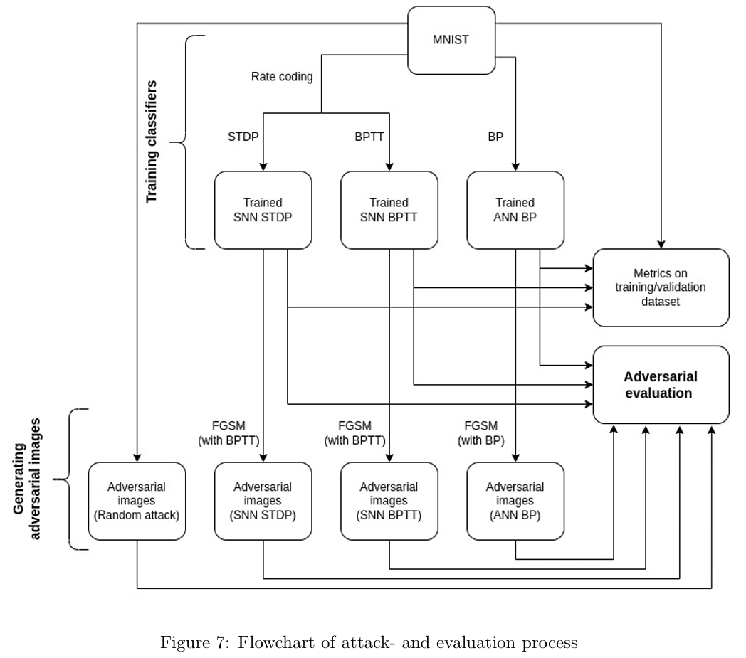
Methodology

Slide 12
Methodology: Data
The writers chose MNIST because of two main reasons:
STDP method performs poorly on complex image classification problem.
Easy to analyze generated adversarial attacks.
Data are preprocessed by resized and gray scaled, and finally normalized.

Slide 13
Methodology: Networks
The authors utilize the model of two layer: Input and processing layer.
Each excitatory neurons are assigned a class, which is the class of the images of digits that has caused most spikes in the neuron.

Slide 14
Methodology: Networks

Slide 15
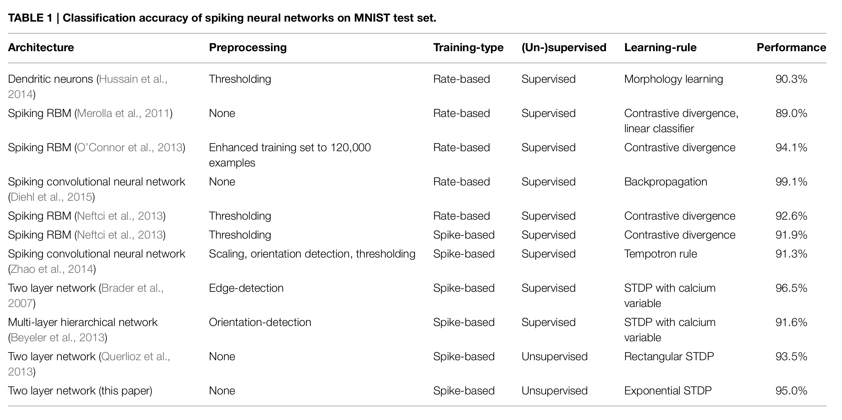
Methodology: Performance of STDP SNN

Slide 16
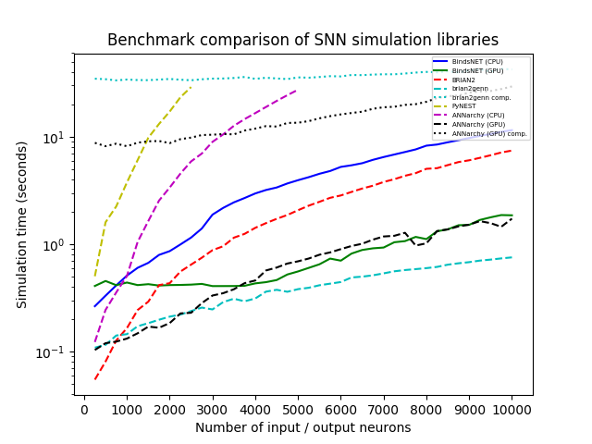
Methodology: Implementation
The python package BindsNET was used for STDP implementation.
BindsNET is implementation of SNN based on pytorch and provides framework to solve ODE.

Slide 17
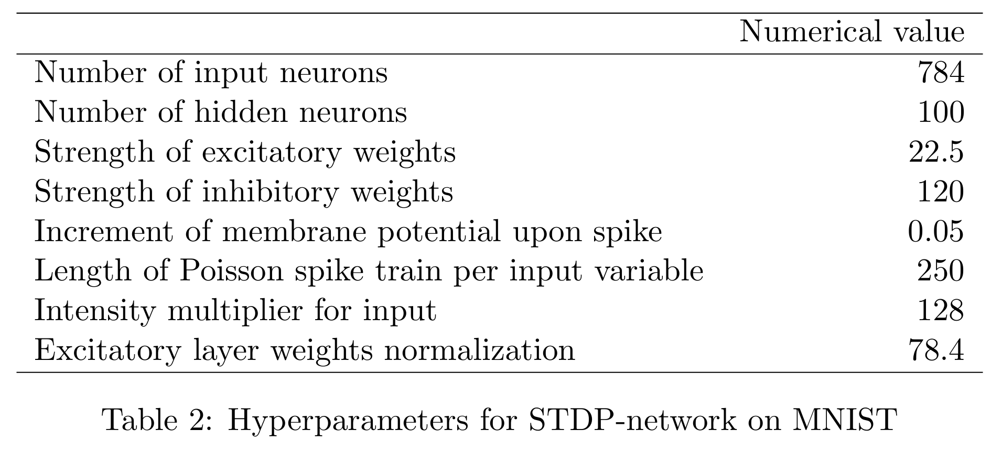
Methodology: Hyperparameters

Slide 18
Methodology: Limitations
Only MNIST dataset is tested.
There are various STDP rules, but only one rule is utilized.
Only FGSM attacks are evaluated.

Slide 19
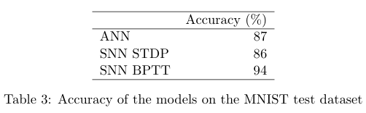
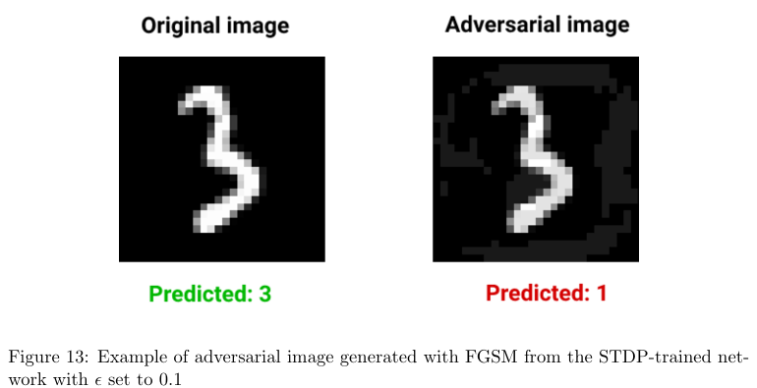
Results

Slide 20
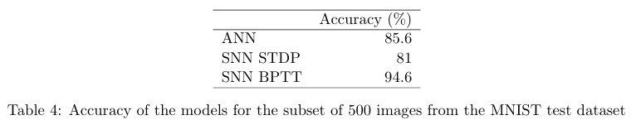
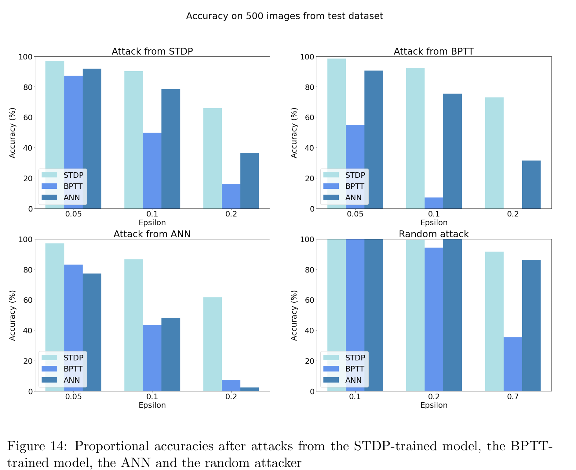
Results

Slide 21
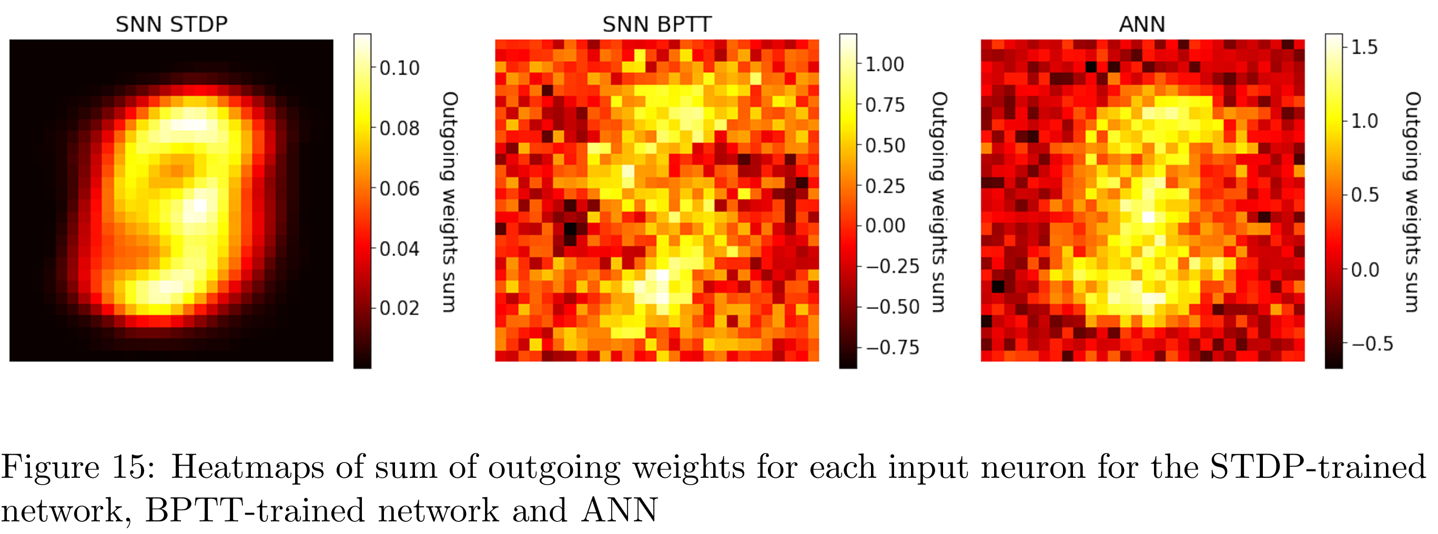
Results

Slide 22
Discussion

Slide 23
Discussion
FSGM is effective on STDP network. It drops accuracy.
In fact, it is not sufficient evidence to tell that FSGM is effective. So, authors conducted random attack, and networks defended random attack well.
ANN is more robust than BPTT SNN. It is different result from previous research.
Maybe STDP trained network shows high bias, low variance.
But regularized ANN shows bad performance, despite of similar heatmap.

Slide 24
Discussion: Future work
Why does STDP-SNN have adversarial robustness?
Analyze STDP-SNN with better accuracy.
More datasets.
Analyze the effect of hyperparameters and architectures to robustness
More categories of attacks.

